Slide 1

Project Maarii
Group 6
Charlie Crewe, George Flude, Alex Polley and Callum Walsh.

Slide 2
Our brief
Use coercive monetisation techniques to generate revenue for a game on a mobile platform

Slide 3
Demographic
Females
35-50
Casual Gamers

Slide 4
Psychographic
Mothers who work short hours or not at all
Have a love of animals, especially smaller breeds
Love of natural landscapes and environments
Love of fantasy media

Slide 5

Game loop
Tap
Reward
Colour

Slide 6
Hook Model
Trigger
Investment
Action
Variable Reward

Slide 7
Tap
Player taps to receive feedback
Easy action in Hook Model
Used to establish a set diegesis of the game world
Tapping the character also provides feedback

Slide 8
Reward
Different actions are rewarded
Colouring Environment
Interacting with the character
Discovering objects in the scene to interact with
Variable Reward from Hook model

Slide 9
Colour
When the scene is touched, it regains colour
Provides investment from the hook model
Different colours give different feedback
Chaining
Matching

Slide 10
Monetisation
Unlock different animals
Hats and accessories
In game currency (Gems)

Slide 11
Player Experience
Actions need to be easy
Single input
Challenge by providing systems to manage
Enjoying the feeling of creation and bringing something to life

Slide 12

Prototype

Slide 13
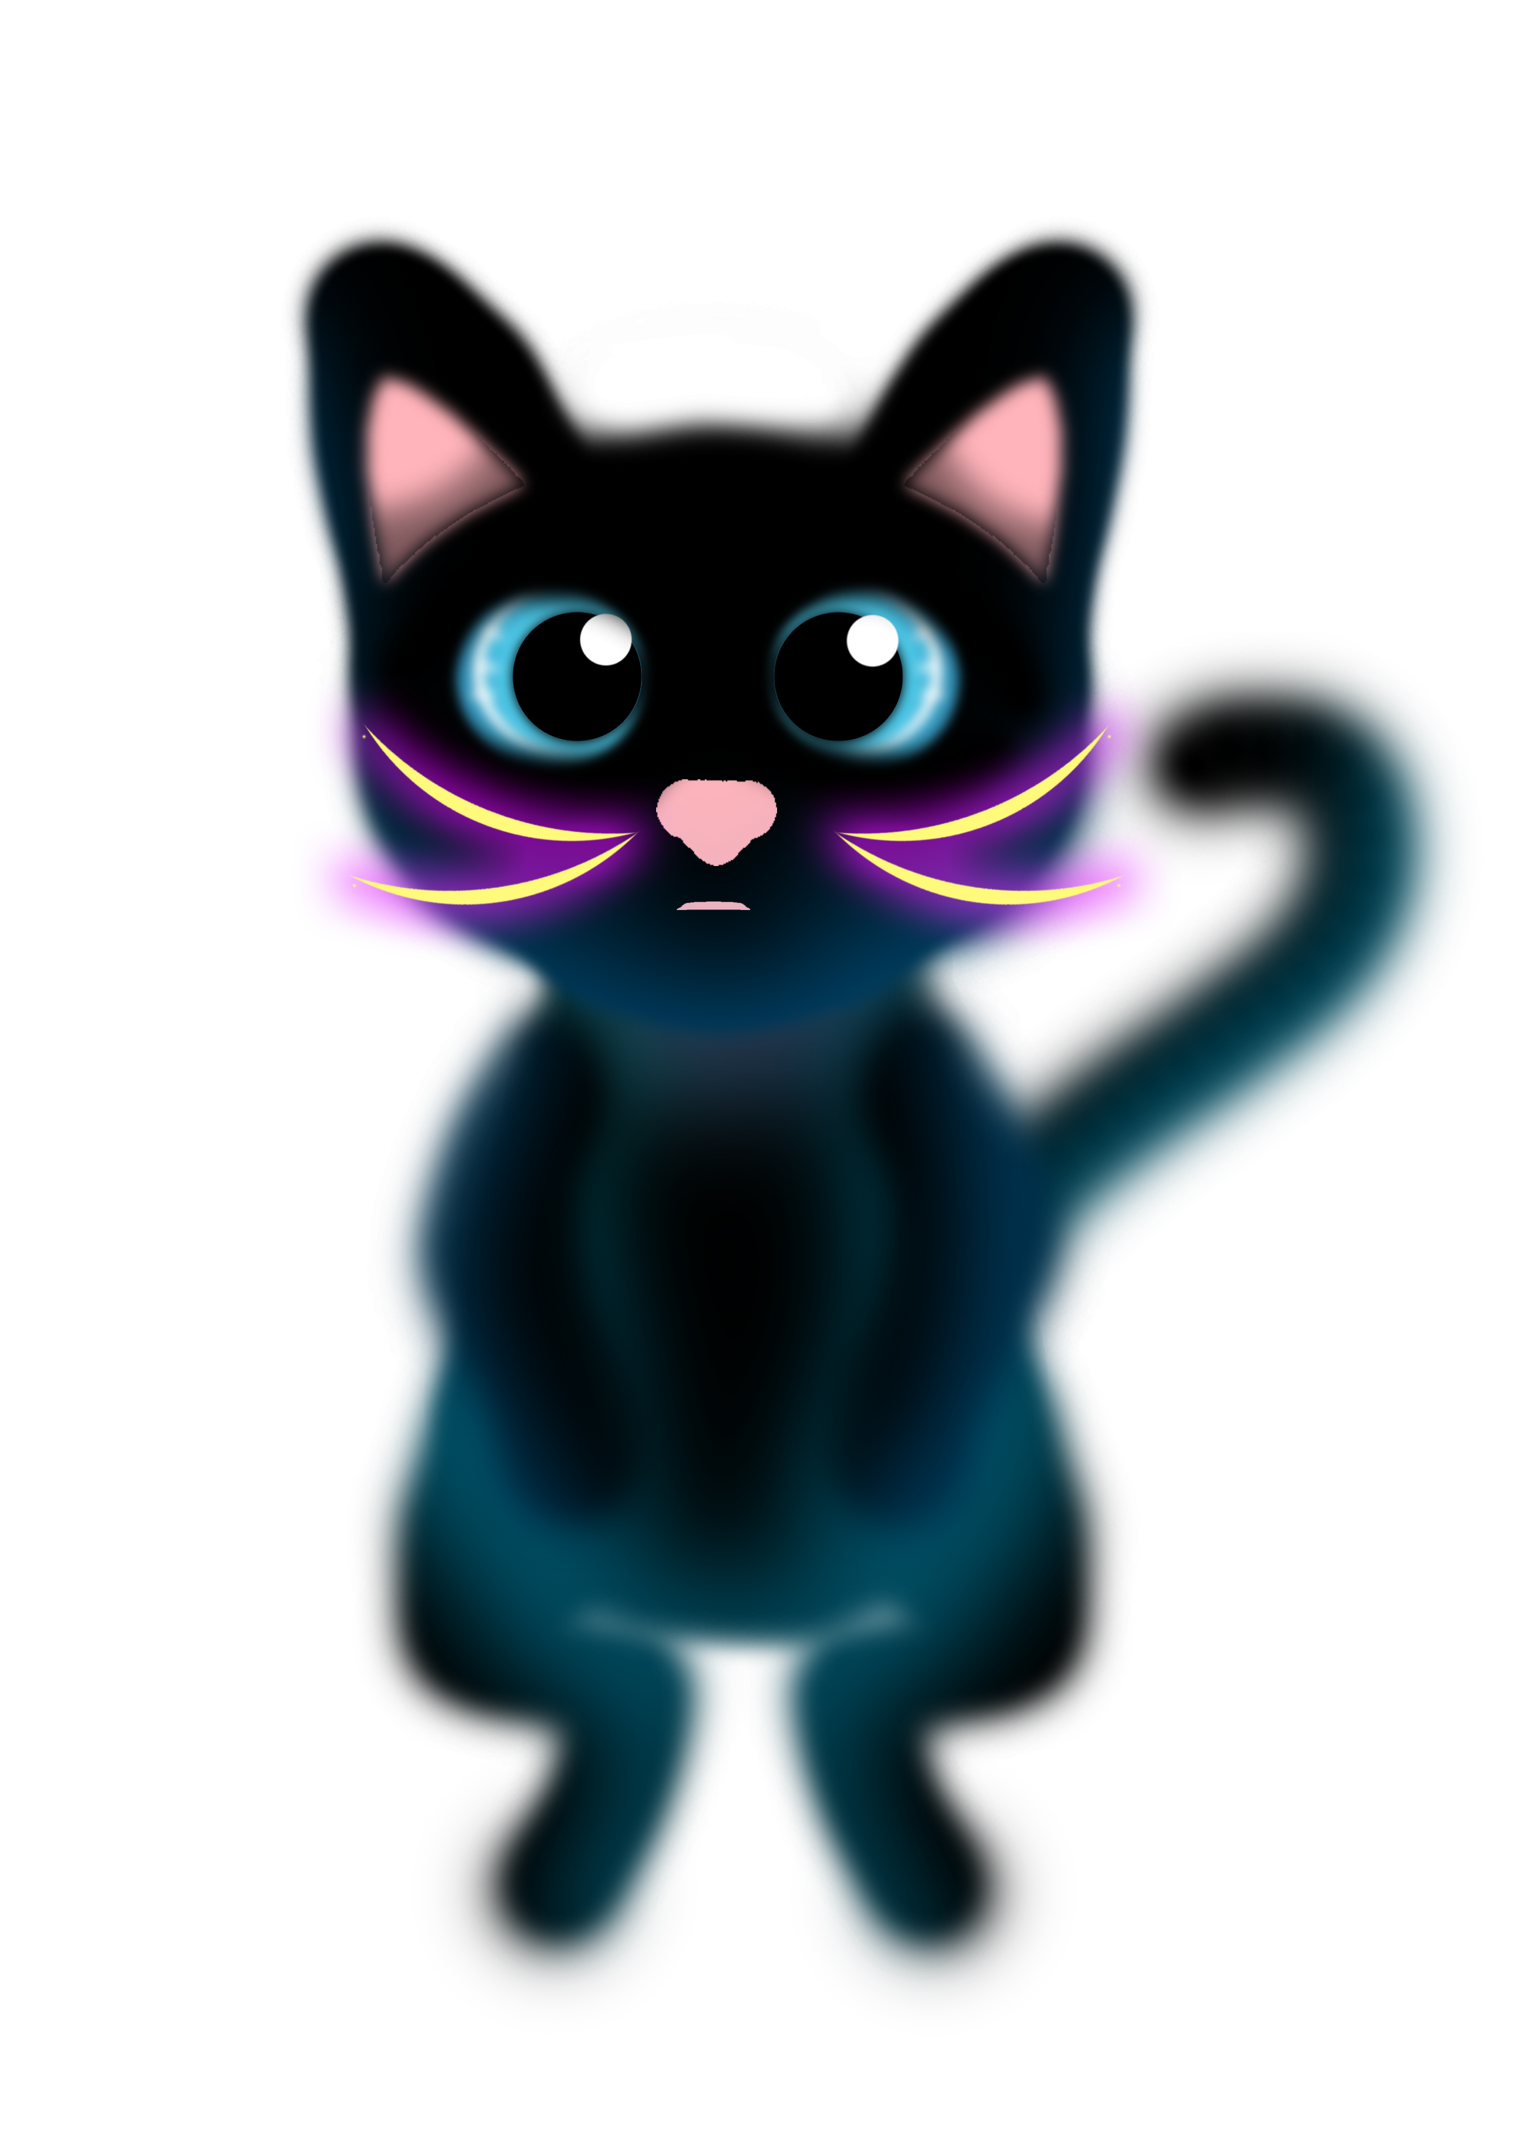

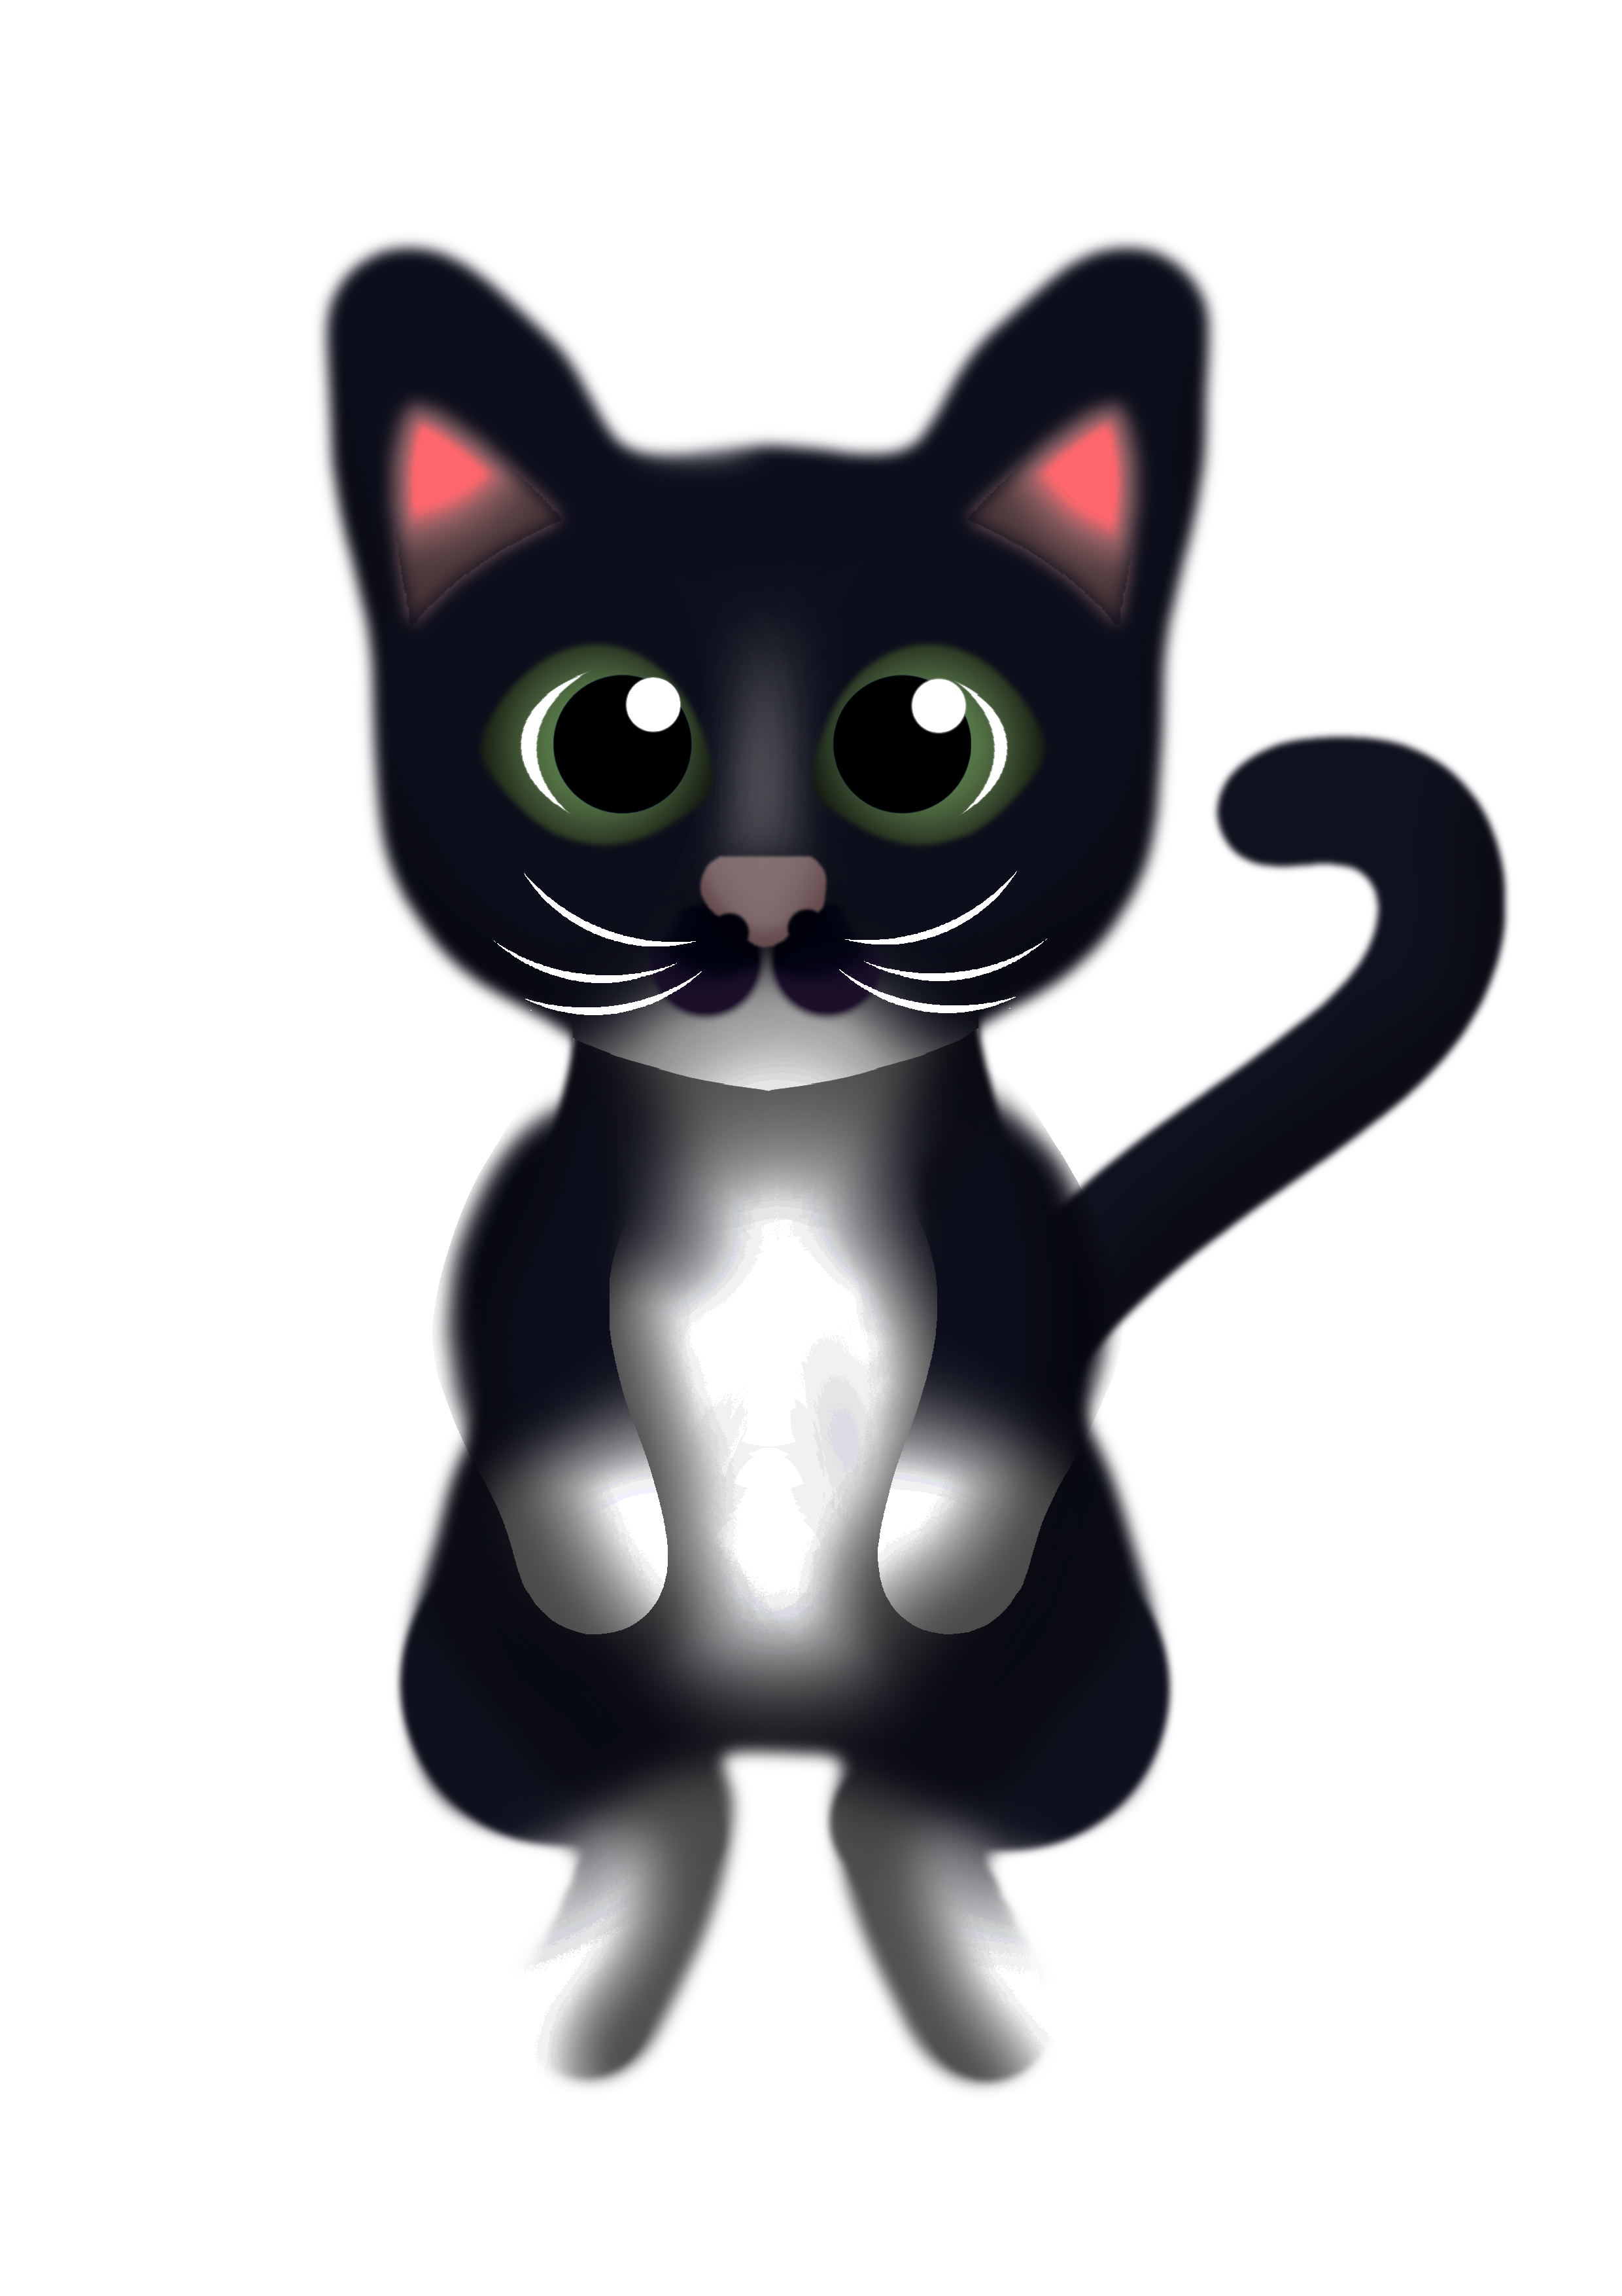
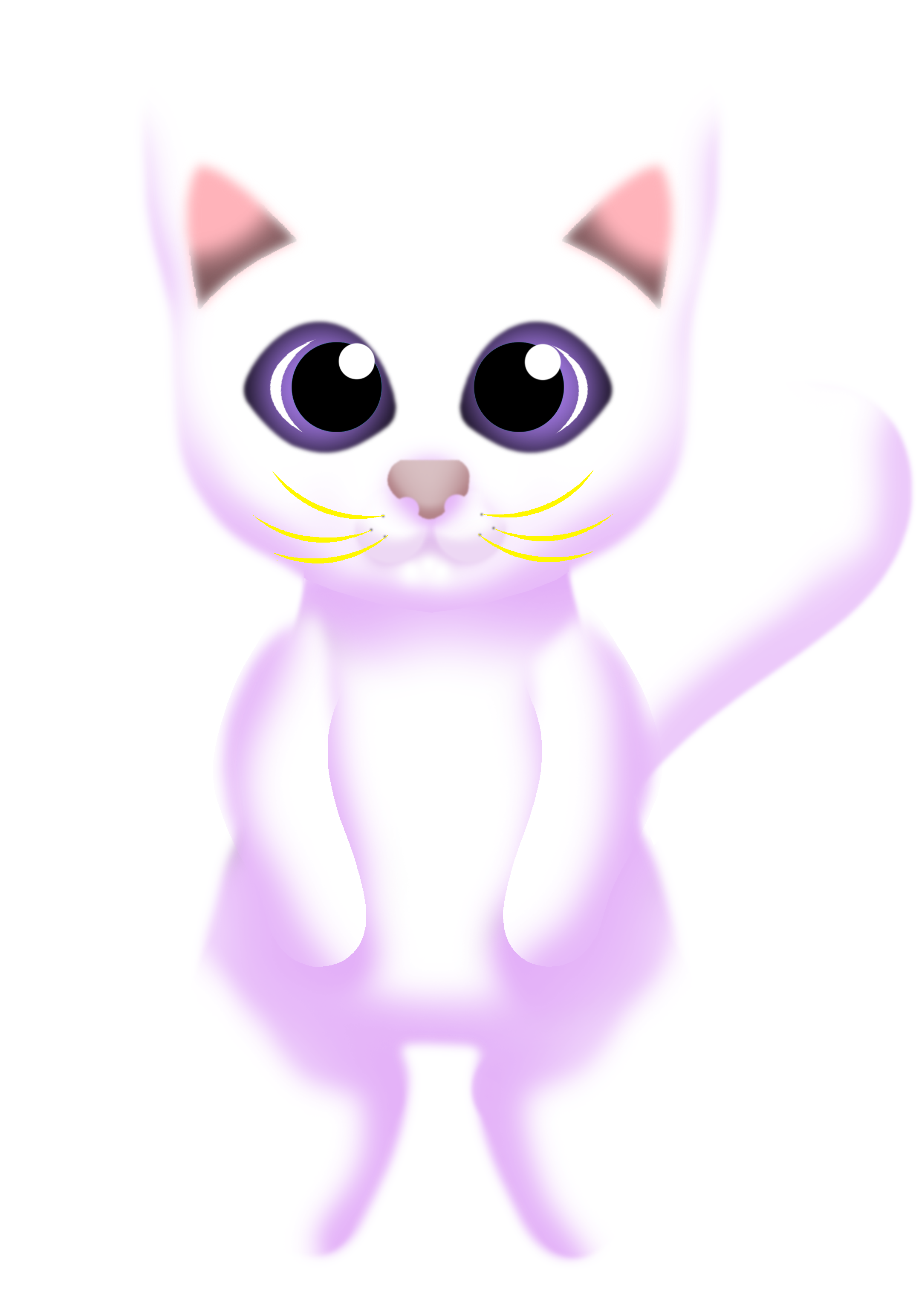
Concepts

Slide 14




Concepts

Slide 15
Platform
Tablet
Screen size suitable for psychographic
Mobile Devices
Provides the means to play on-the-go

